Slide 1


Slide 3
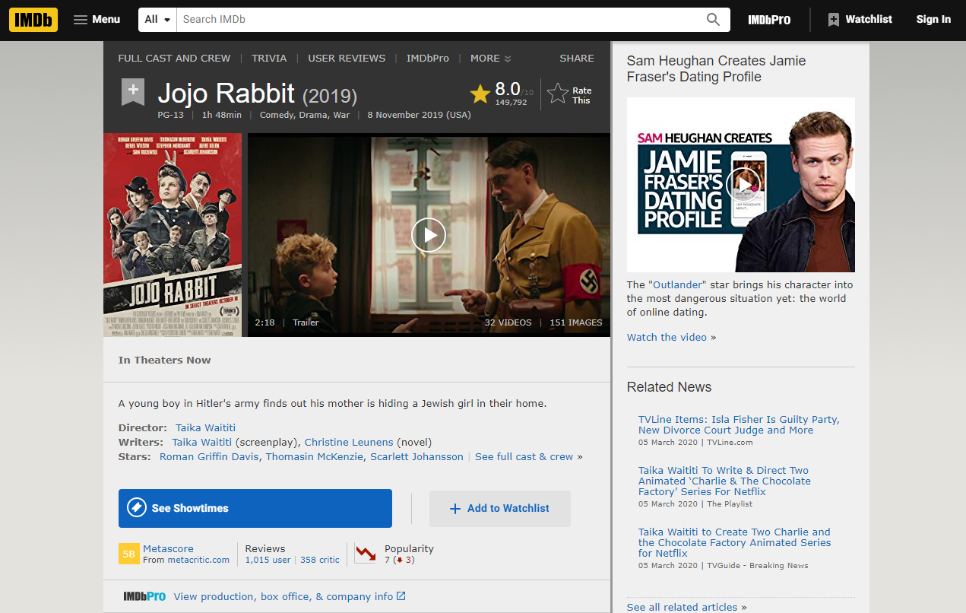

Slide 4

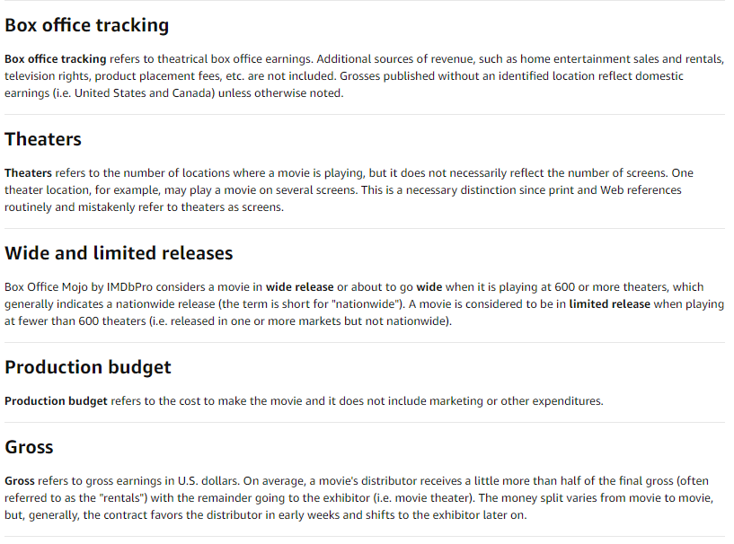
For Gross Income, we considered all the data in the database

Slide 5
Considerations - General data
# Directors | 2,630
# of Movies | 5,913
Max # Movies per Director | 34
Years | 1931 to 2019

Slide 6
Question 1: Viewer vs. Critic Ratings
Viewer Ratings → “Weighted Average Vote” of all viewer ratings for a specific movie
Critic Ratings → Weighted score based on IMDb’s “Metascore” methodology

Slide 7
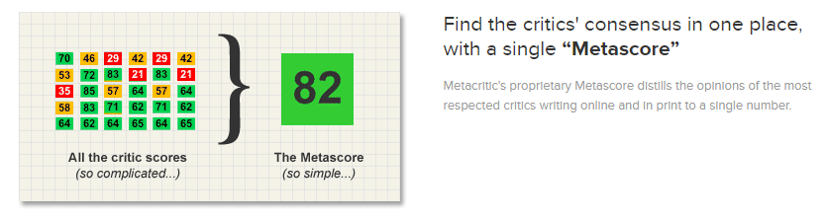
WEIGHTED AVERAGE VOTE:
IMDb registered users can cast a vote (range from 1 to 10).
Individual votes are then aggregated and summarized as a single IMDb rating.
one vote per title per user.
METACRITIC SCORE:
IMDB assigns more importance, to some critics and publications, based on quality and overall stature.
A movie gets a Metascore when at least four critics review that movie.
Range from 0-100.
IMDB normalizes the resulting scores (akin to "grading on a curve" in college), which prevents scores from clumping together.

Slide 8
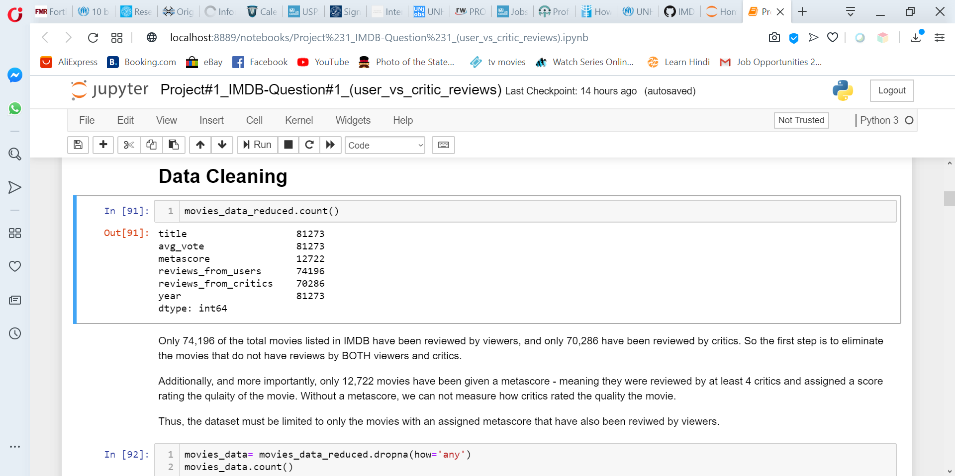
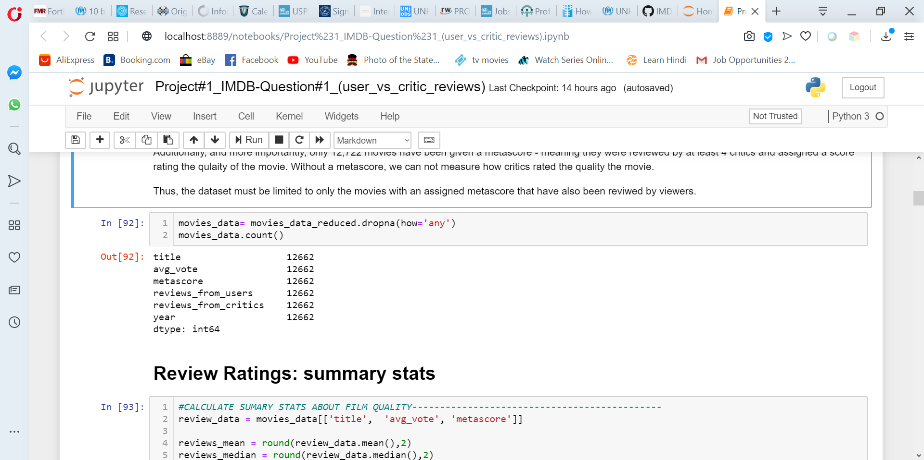
Data Cleaning
only 74,196 of the total movies listed in IMDB have been reviewed by viewers
only 70,286 have been reviewed by critics.
more importantly, only 12,722 movies have been given a metascore

Slide 9
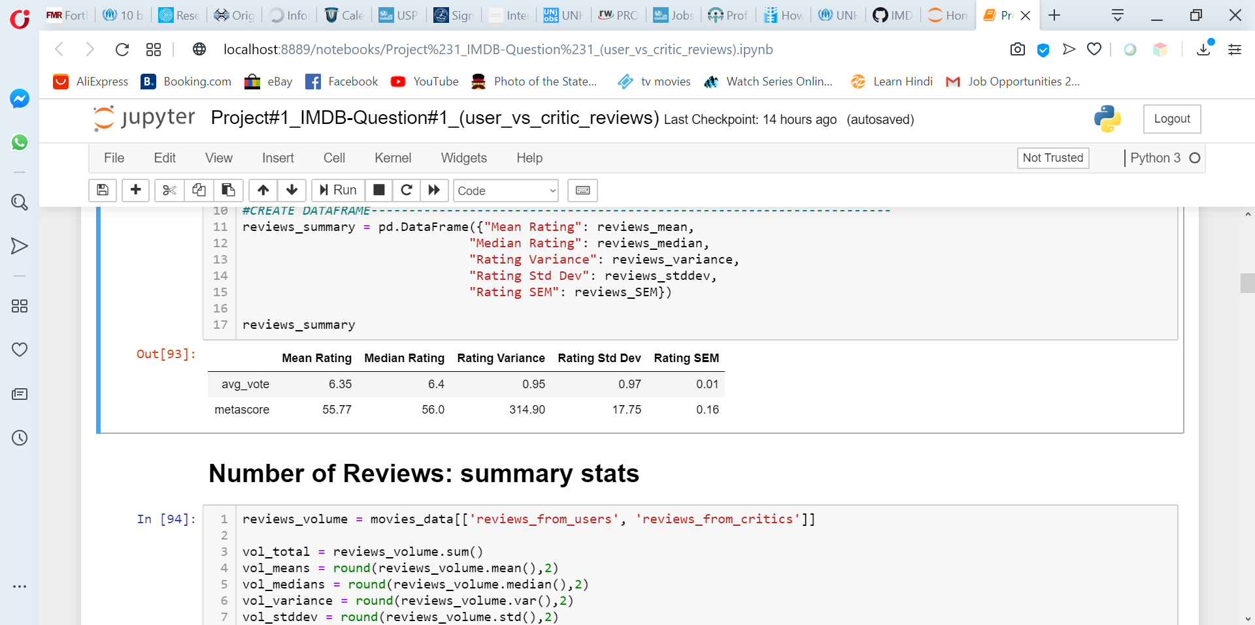
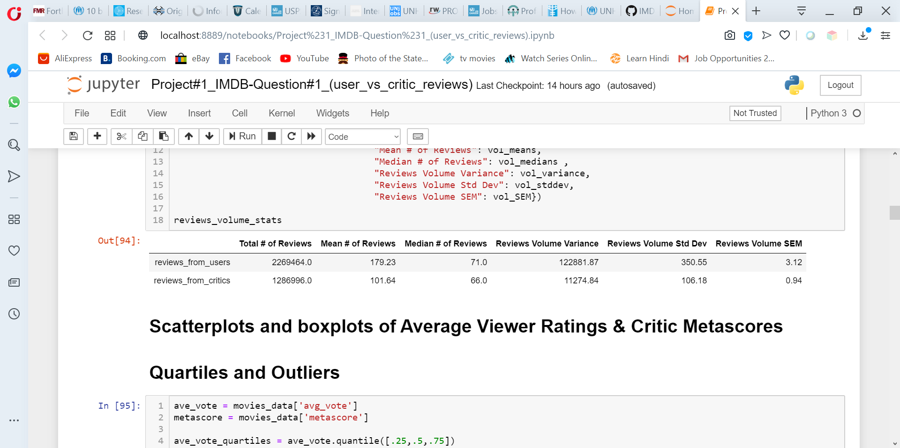
# of Reviews: Greater numbers of overall user reviews than critic reviews, but more consistency in the number of critic reviews of any given movie received vs. the number of user reviews each movie received.
Quality Ratings: more variability in the quality ratings given to movies by critics than by users → there was more consistency among what the viewers thought of the quality of the movie than what the critics thought.

Slide 10
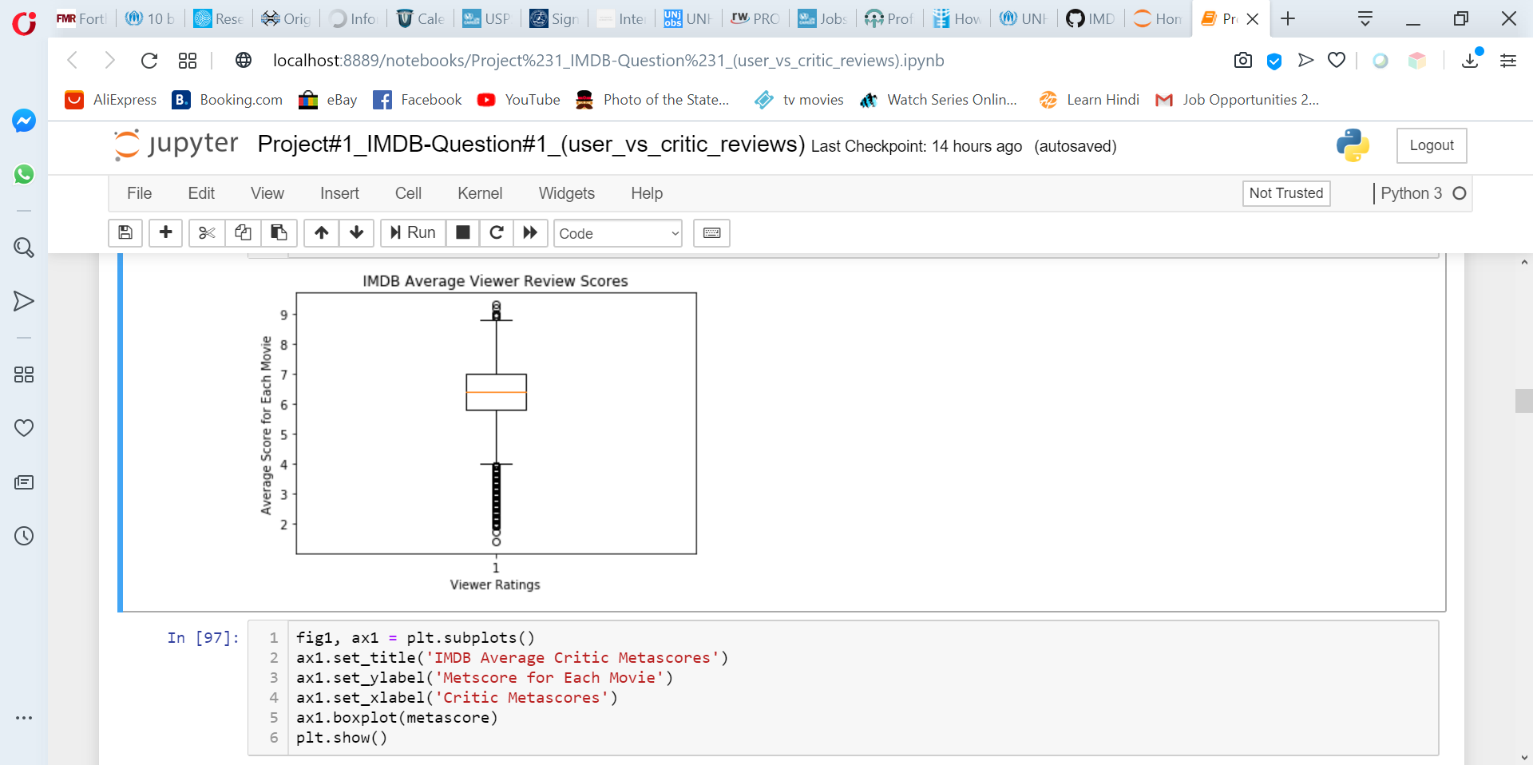
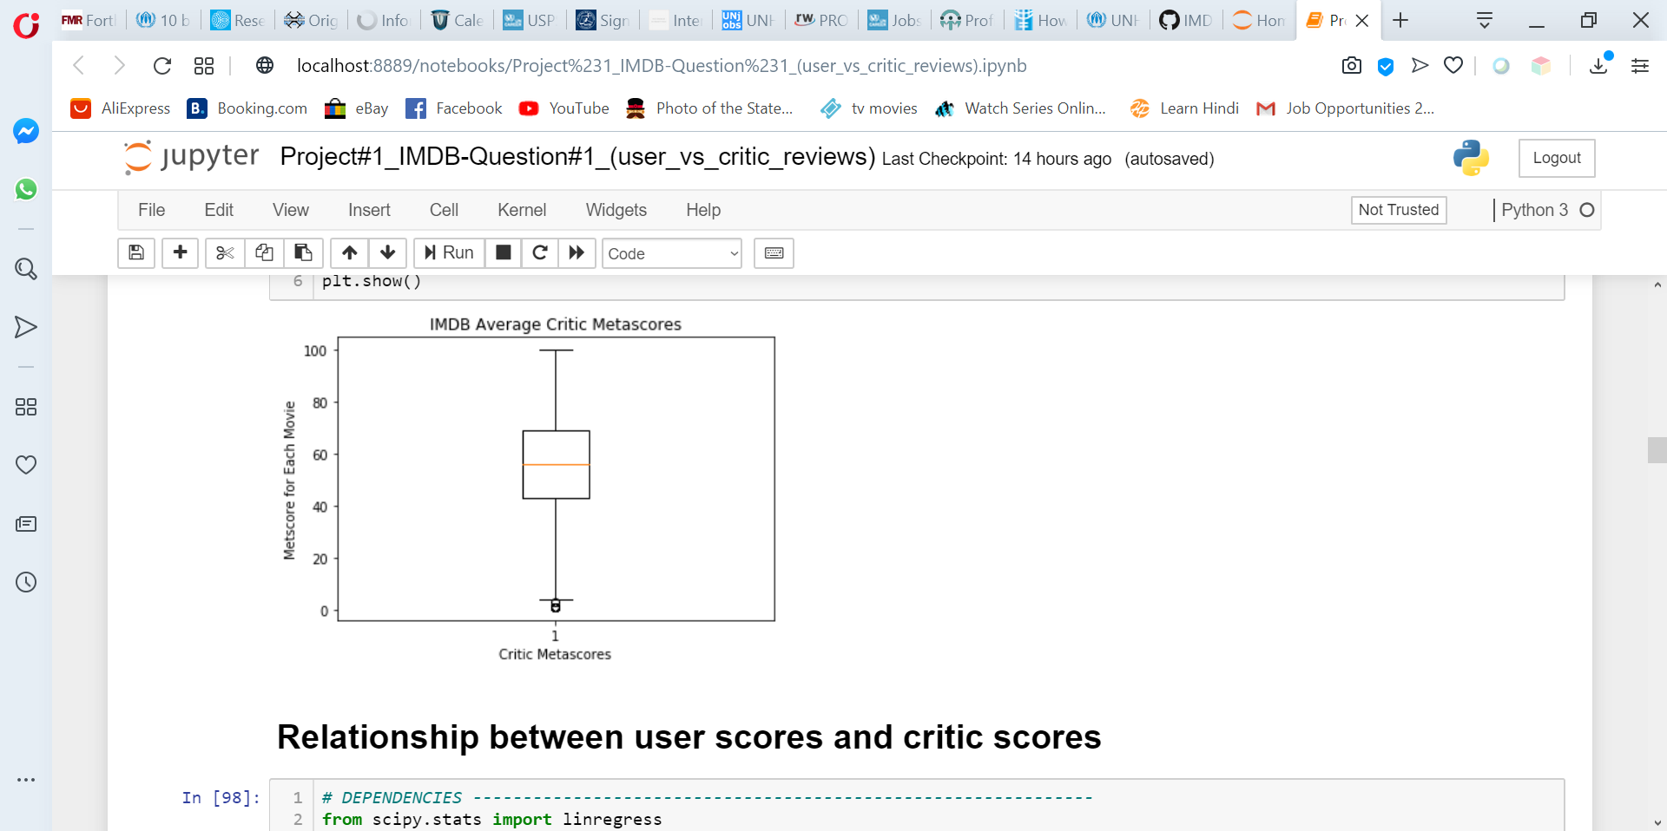
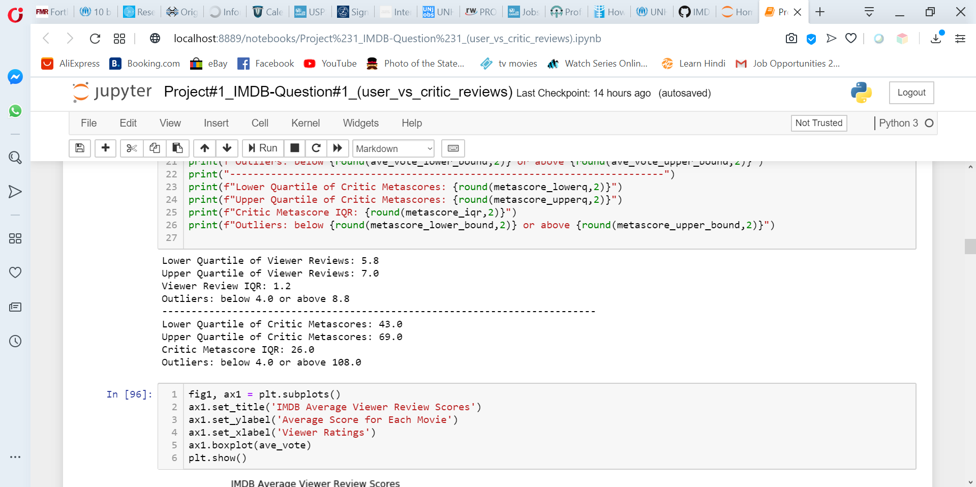
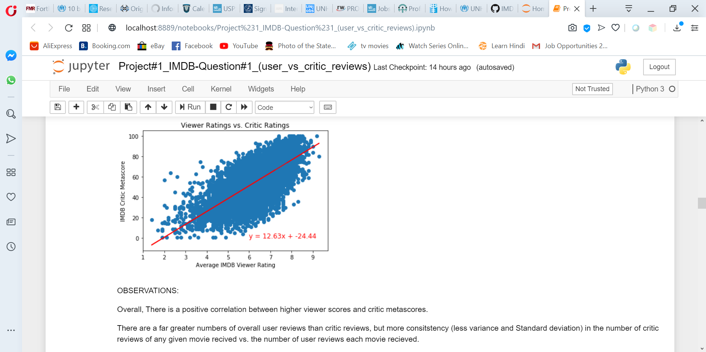

Slide 11
Viewers vs. Critics: Summary
Overall, There is a positive correlation between higher viewer scores and critic metascores.
With the metascore methodology applied by IMDB, critic metascores are already normalized (i.e. adjusted to a normal curve).
Viewer ratings are scaled from 1-10, metascores are scaled 1-100
Not be directly comparable without additional statistical analysis.
If we compare ave metascore relative to its range (1-100) to the ave voter score relative to its range (1-10), viewers do seem to rate movies overall slightly more favorably than critics.

Slide 12
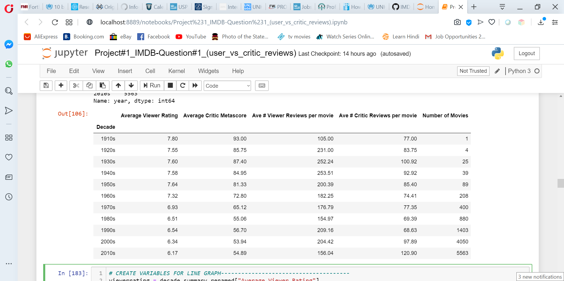
Viewer Ratings by film production year

Slide 13
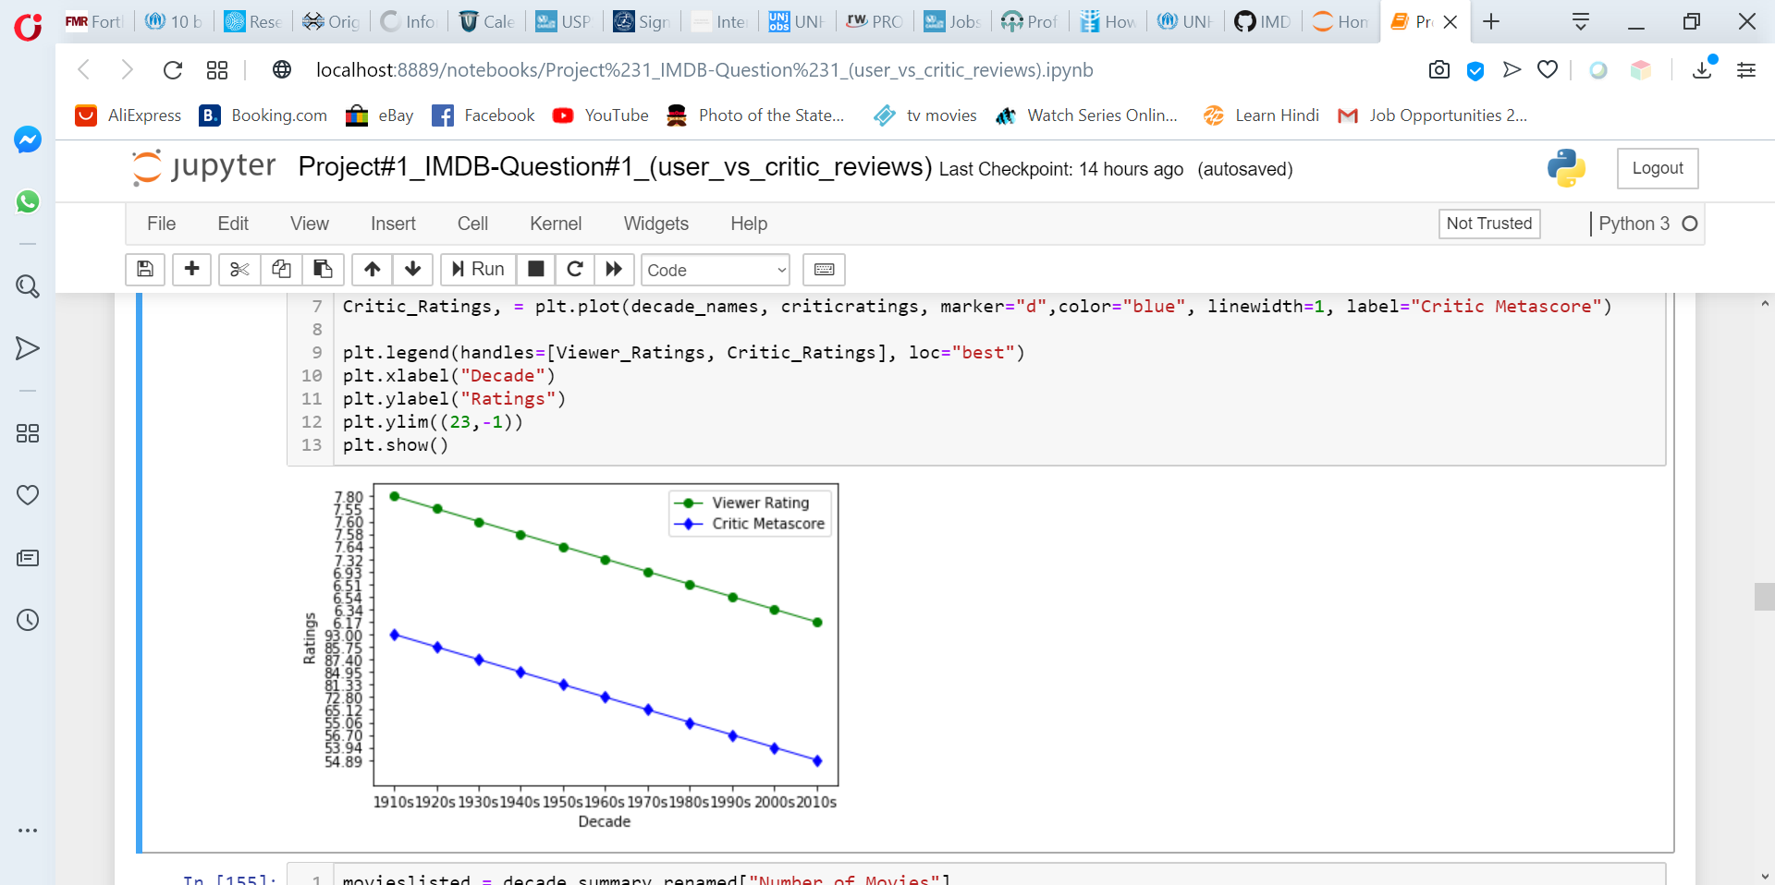
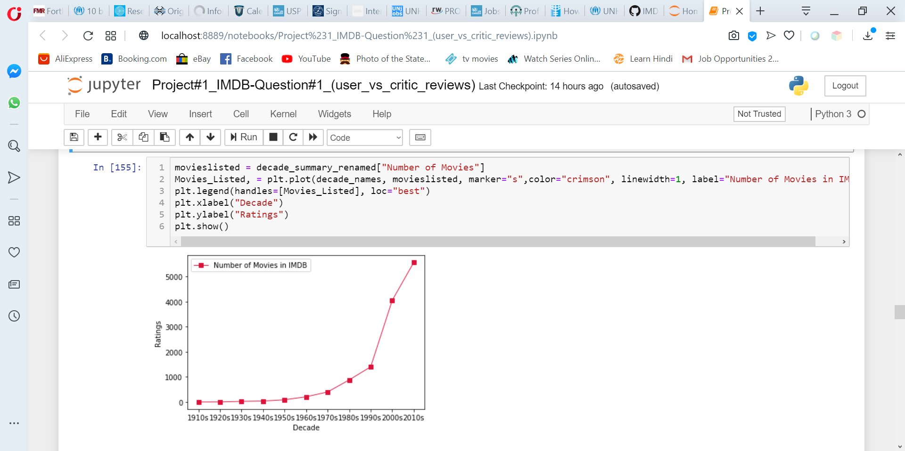
Both viewers and critics rated movies from 1960s and earlier higher.
Majority of the movies in IMDB were made in the 1970s and afterwards.
It could be that the better the quality of movies made before 1970, the more likely it is to be listed and reviewed on IMDB.

Slide 14
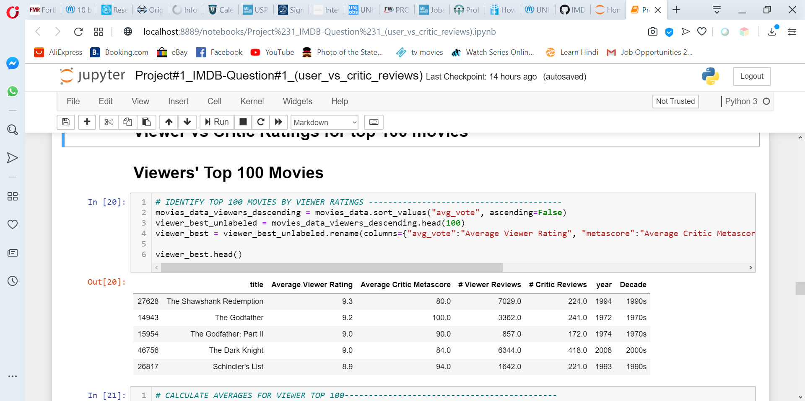
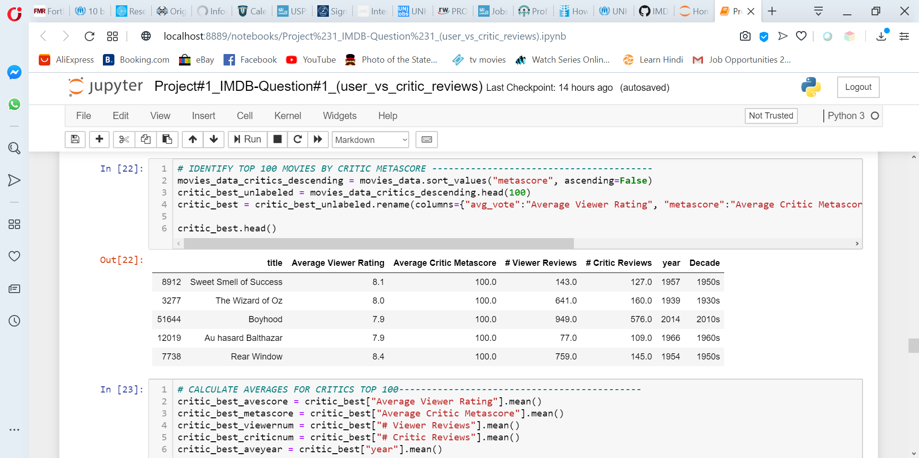
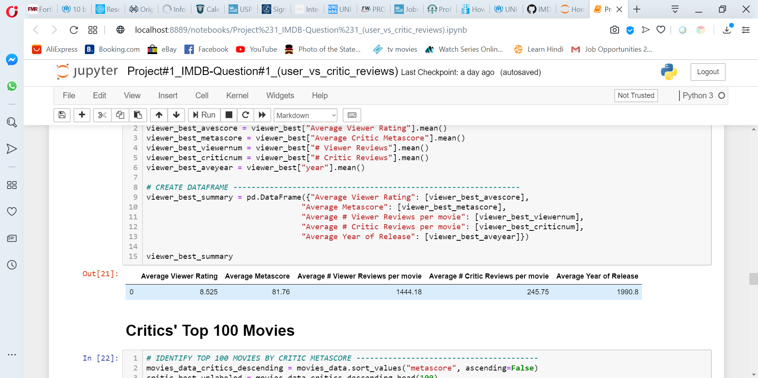
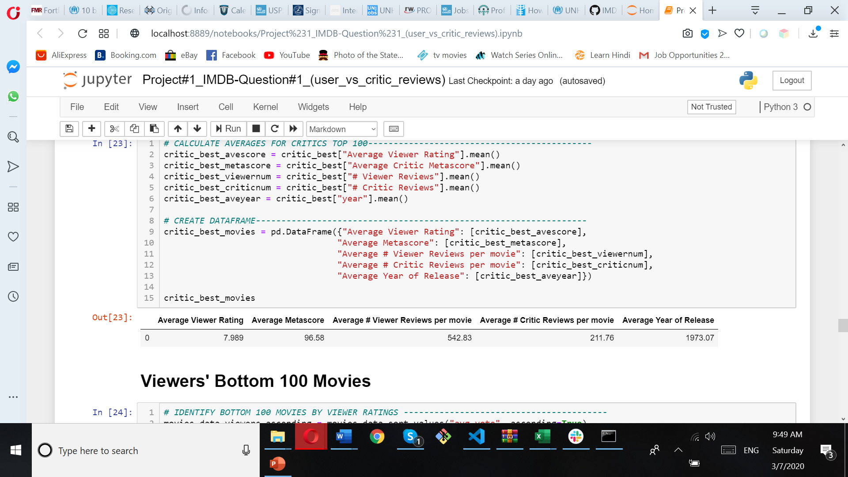
Top Movies
VIEWERS
CRITICS
Viewers:
Critics:

Slide 15
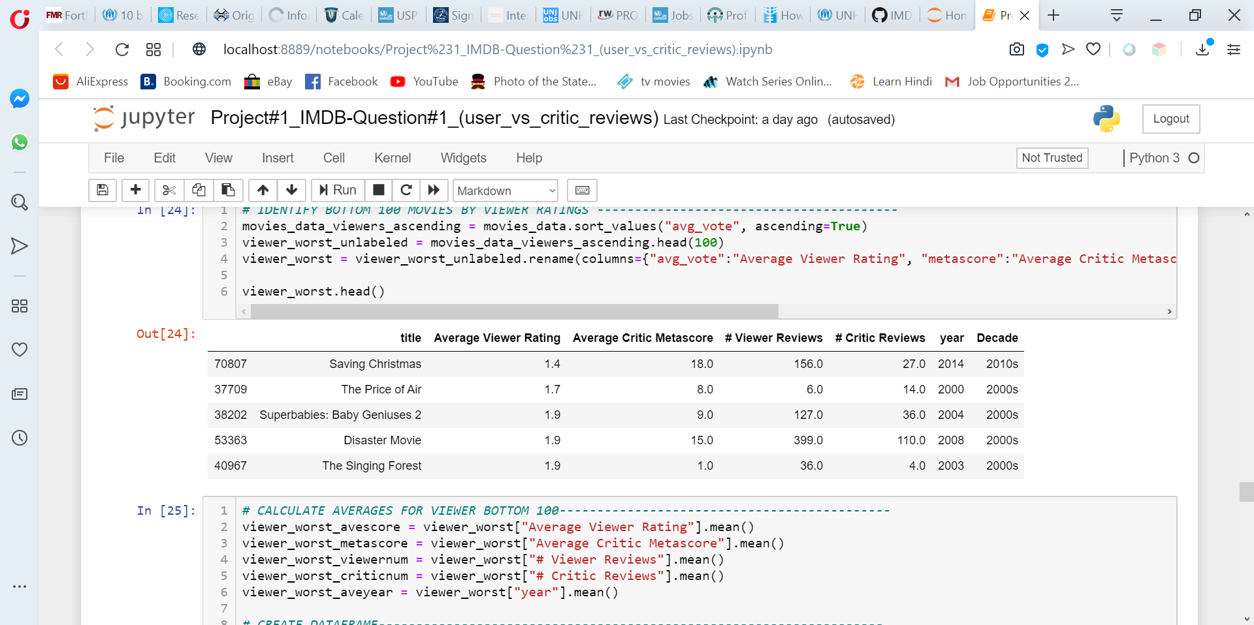
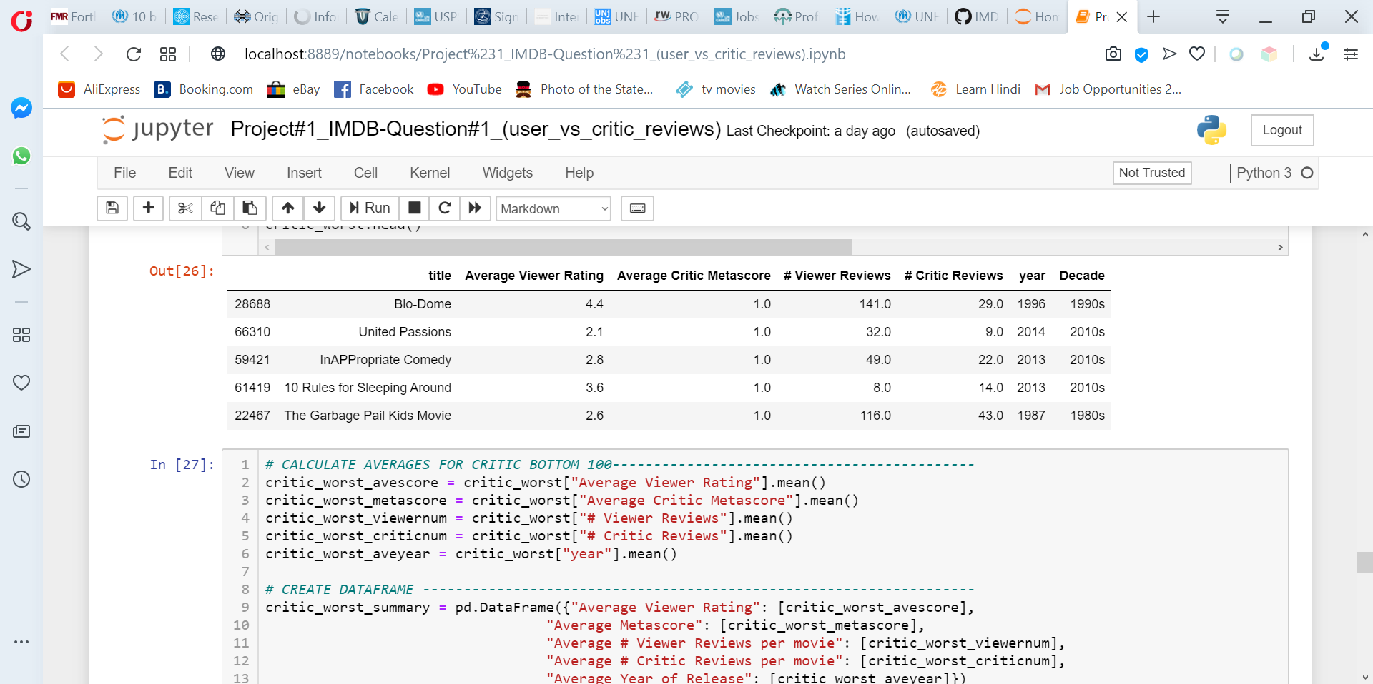
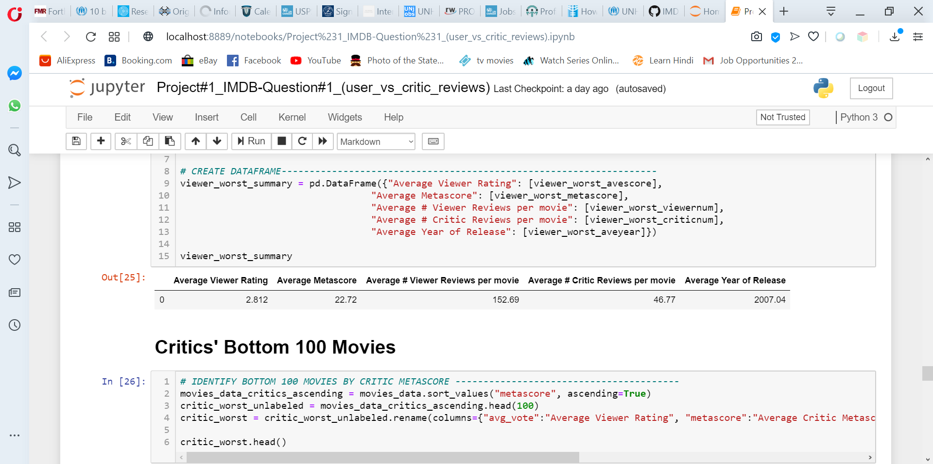
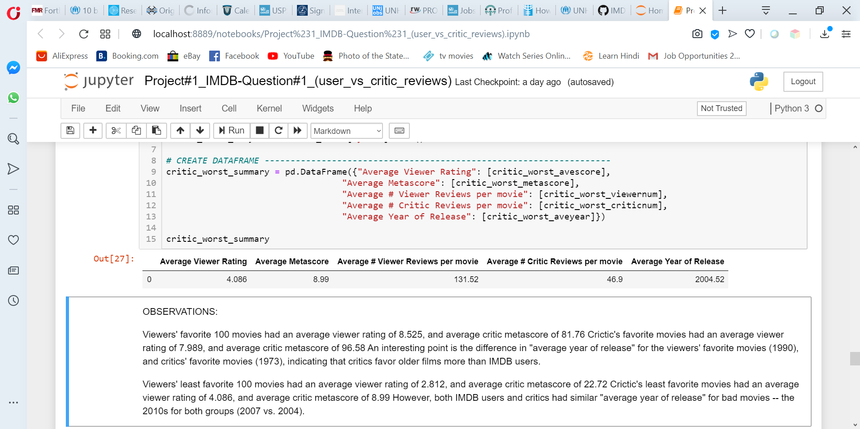
Worst Movies
VIEWERS
CRITICS
Viewers:
Critics:

Slide 16
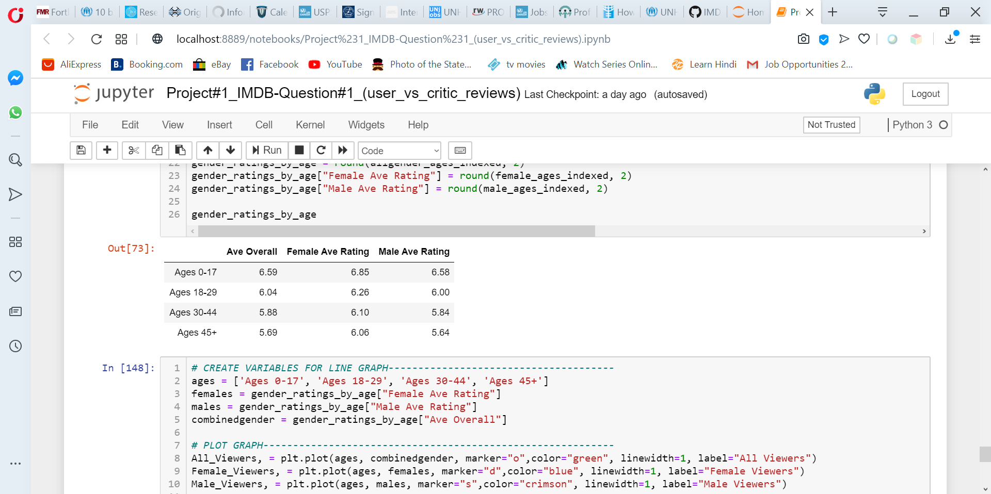
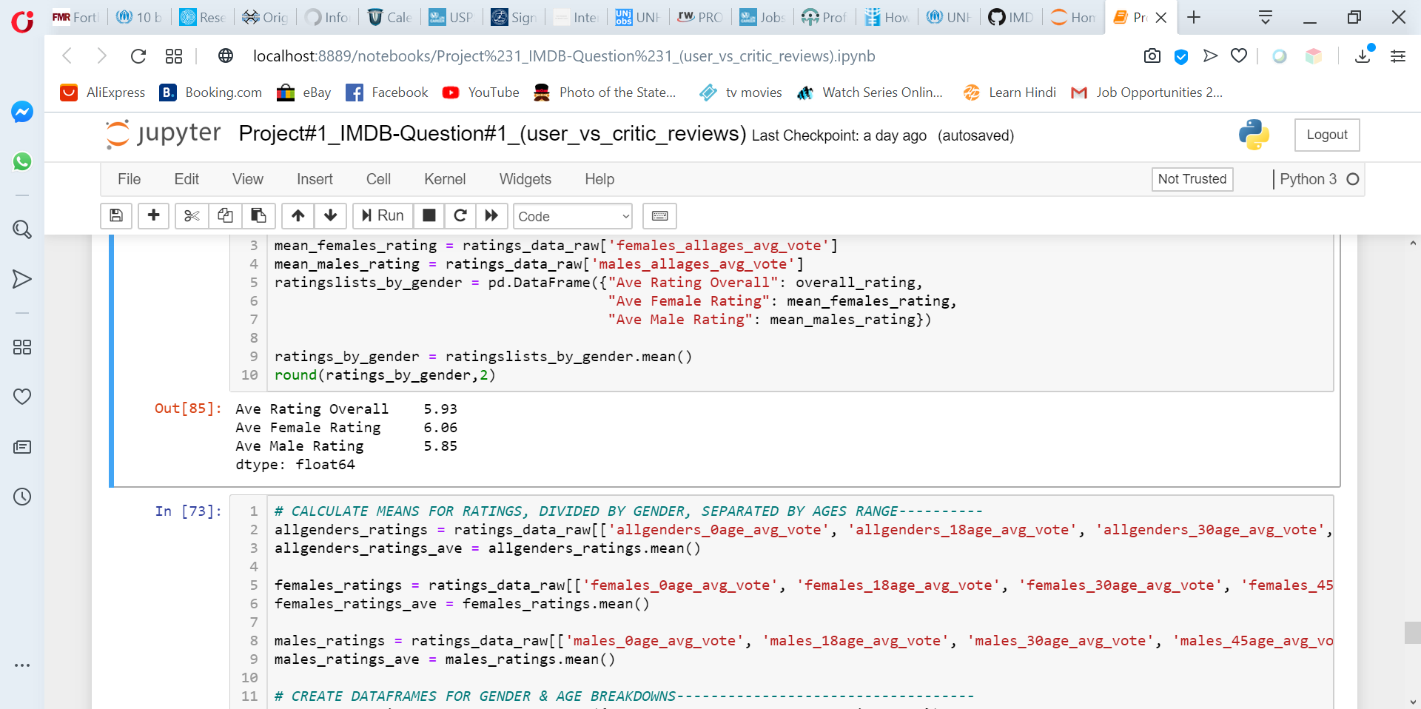
Viewer ratings by Gender

Slide 17
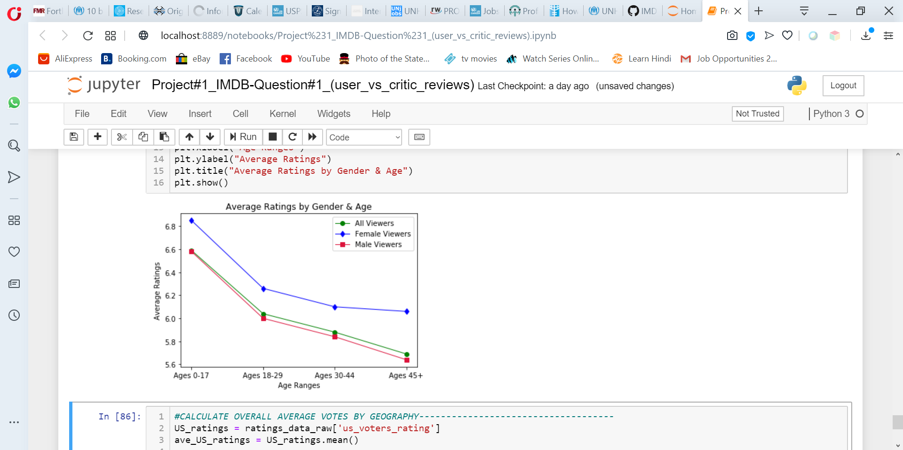

Slide 18
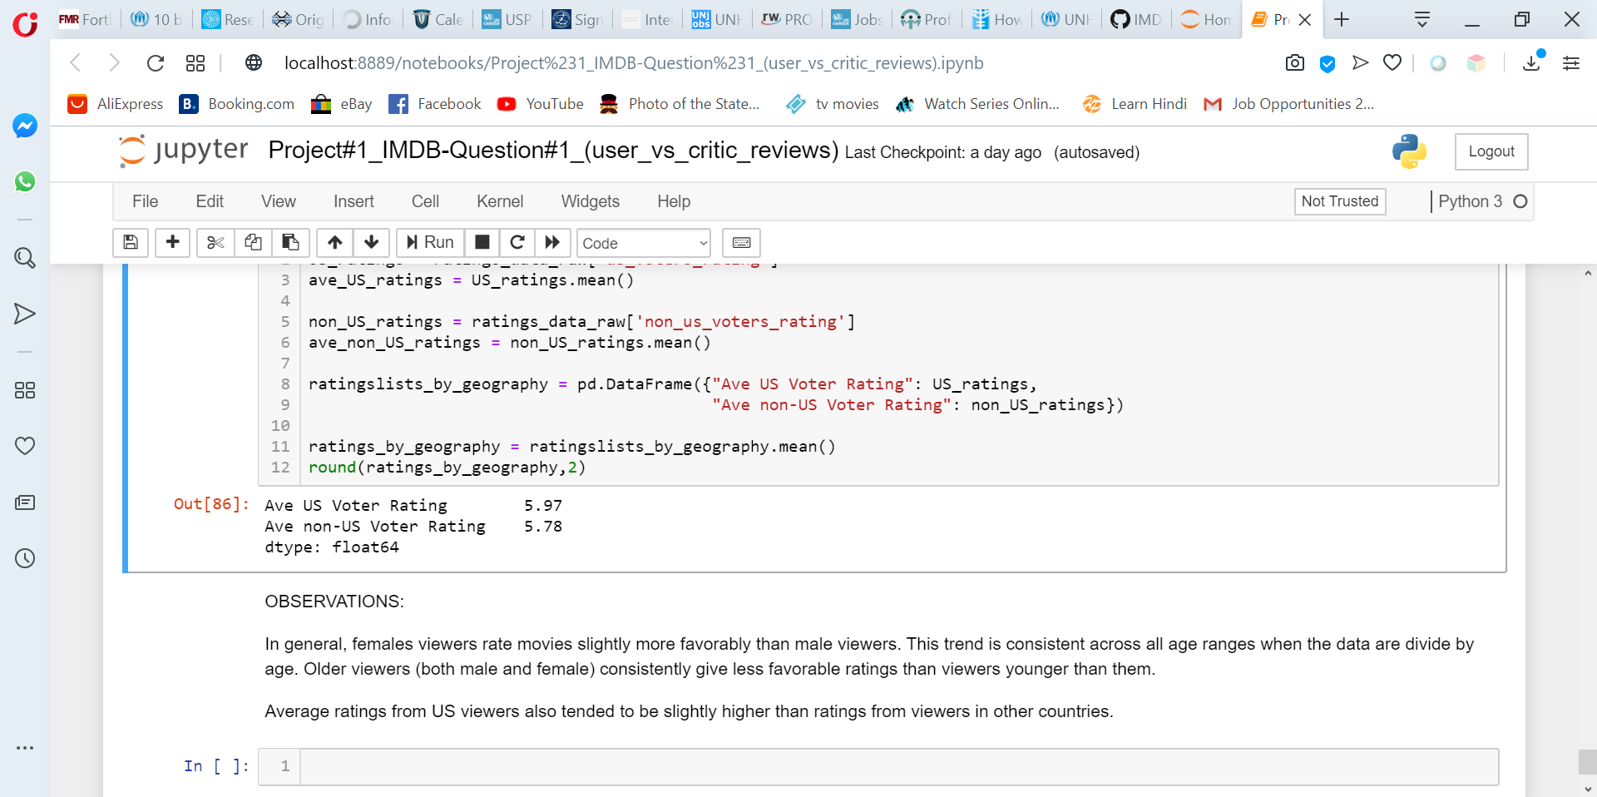
Viewer Ratings: US vs. Non-US
Females viewers rate movies slightly more favorably than male viewers. This trend is consistent across all age ranges when the data are divide by age.
Older viewers (both male and female) consistently give less favorable ratings than viewers younger than them.
Average ratings from US viewers trend slightly higher than for viewers in other countries.

